Slide 1

MAHATMA GANDHI INSTITUTE OF TECHNOLOGY(A) DEPARTMENT OF INFORMATION TECHNOLOGY
An Industry Oriented Mini Project(CB652PC)
on
IntoxiCheck Alert: IoT-Based Real-Time Alcohol Sensor System
by
Katepally Srikanth – 22261A1234
V. Bindu Sri – 22261A1261
Batch ID - IT-25-30
Internal Supervisor
Mrs. Ch. Lakshmi Kumari
Assistant Professor
IOMP Supervisor
Dr. U. Chaitanya
Assistant Professor

Slide 2
OUTLINE
Abstract
Introduction
Existing System
Proposed System
Applications
Software & Hardware Requirements
Literature Survey
Problem Statement
Objectives
Module Description
Algorithm
Design (Architecture and UML Diagrams)
Code execution and results
Test Cases
Conclusion and future enhancements
References

Slide 3
ABSTRACT
In recent years, drunk driving has claimed many lives, and it places people at risk on the roads, both behind the wheel and in pedestrian shoes. The system employs an MQ-3 alcohol sensor to assess the alcohol level in breath on the entry of a driver into the vehicle. If alcohol above a certain level is detected, some safety measures are taken. The buzzer sounds an alarm, and the seat's vibration motor warns the driver. Further, an LED warning system alerts the surrounding individuals.
This kind of integration with IoT technology allows for real-time monitoring and instant alerts, thereby making this system a proactive solution to prevent any drunk-driving incident. All these features put together by IntoxiCheck to prevent accidents are the detection of alcohol, alerting in real-time, and communication for emergencies, thus encouraging responsible driving.

Slide 4
INTRODUCTION
Drunk driving is a major cause of road accidents, leading to numerous fatalities and injuries each year. It poses significant risks not only to the drivers but also to pedestrians and other road users. To address this issue, the IntoxiCheck Alert system has been developed as a proactive solution to improve road safety. This system leverages IoT technology to detect alcohol levels in a driver's breath using an MQ-3 alcohol sensor. By enabling real-time monitoring and instant alerts, IntoxiCheck Alert aims to prevent drunk driving incidents, encourage responsible driving, and enhance overall road safety.

Slide 5
EXISTING SYSTEM
Manual Checking by Police – Breathalyzer tests at checkpoints are used but not always effective as they depend on random checks.
Warning Systems – A few modern vehicles have dashboard alerts or passive alcohol sensors, but these are mostly in high-end cars.
No Real-Time Alerts – There is no automated system to instantly inform family, police, or emergency services if a driver is drunk.
Limited Prevention – Existing methods mostly detect alcohol after a driver is already on the road, increasing the risk of accidents.

Slide 6
PROPOSED SYSTEM
The alcohol detection system utilizes the MQ-3 sensor to identify the presence of alcohol in the driver’s breath, ensuring early detection of intoxication. Upon detection, a series of safety alerts are triggered, including a buzzer, seat vibration, and LED warning system, effectively notifying both the driver and nearby individuals. To enhance safety, the system is integrated with IoT-based monitoring, enabling it to send real-time alerts to family members or concerned authorities for prompt intervention. By combining these features, the system plays a crucial role in accident prevention by actively alerting the surroundings if the driver is found to be under the influence.

Slide 7
APPLICATIONS
Personal Vehicles – Prevents drunk driving.
Public Transport – Ensures driver sobriety.
Corporate Fleets – Monitors company drivers.
Law Enforcement – Aids police detection.
Rental Vehicles – Enhances passenger safety.

Slide 8
HARDWARE AND SOFTWARE SPECIFICATIONS
Hardware
Software
MQ-3 alcohol sensor
microcontroller (Arduino)
vibrating motor
buzzer
LED system
Bread Boards
Connecting wires
Resistors and Capacitors
Arduino IDE
Embedded C
MQ-3 sensor library

Slide 9
LITERATURE SURVEY
S.NO | AUTHOR NAMES, YEAR OF PUBLICATION | JOURNAL OR CONFERENCE NAME AND PUBLISHER | METHODOLOGY / ALGORITHM / TECHNIQUES USED | MERITS | DEMERITS | RESEARCH GAPS
1 | L. M. Barba-Maza, C. Sánchez-López (2016) | 2016 IEEE International Autumn Meeting on Power, Electronics and Computing (ROPEC), IEEE | Development of a breathalyzer for drivers using sensor-based alcohol detection | Provides an effective alcohol detection mechanism | Lacks real-time reporting features | No IoT-based connectivity for remote monitoring
2 | Uzairue, S. et al. (2018) | Lecture Notes in Computer Science, ICCSA 2018, Springer | IoT-enabled alcohol detection integrated with smart city infrastructure | Enhances road safety using IoT | May require stable internet and infrastructure | Needs broader implementation in real-world systems
3 | I. F. Rahmad et al. (2019) | 2019 7th International Conference on Cyber and IT Service Management (CITSM), IEEE | Application of MQ-303A sensor for alcohol detection in drivers | Reliable alcohol detection using MQ-303A | No additional safety measures like buzzer alerts | No automatic vehicle control or emergency messaging

Slide 10
4 | Tamoghna Sarkar, Sukriti Shaw (2020) | 4th International Conference on Big Data and Internet of Things (BDIoT), ACM | IoT-based intelligent alcohol detection system for vehicles | Uses smart technology to prevent drunk driving | Might have response time delays | Needs better integration with emergency services
5 | M. Hariharan et al. (2024) | 2024 International Conference on Sustainable Communication Networks and Application (ICSCNA), IEEE | Realtime alcohol detection with ESP8266 for engine locking | Integrates IoT for real-time monitoring | Dependent on internet connectivity for alerts | Limited testing on different vehicle models

Slide 11
PROBLEM STATEMENT
Drunk driving is one of the leading causes of road accidents, putting both the driver and others at risk. Traditional methods like manual breathalyzer tests are inefficient, reactive, and require human intervention.
The proposed system aims to build a low-cost, IoT-supported alcohol detection system that continuously monitors the driver’s breath using an MQ-3 sensor. Upon detecting alcohol above a set threshold, the system will alert the driver through a buzzer, trigger LED indicators to warn surroundings, and activate a seat vibration motor to physically alert the driver.
This real-time alert mechanism helps in proactive drunk-driving prevention, making roads safer.

Slide 12
OBJECTIVES
To detect the presence of alcohol in the driver’s breath using the MQ-3 alcohol sensor.
To alert the driver and surroundings using a buzzer, LED indicators, and a vibration motor when alcohol is detected.

Slide 13
MODULES DESCRIPTION
Alcohol Detection Module
Uses the MQ-3 sensor to detect alcohol levels in the driver’s breath.
If alcohol exceeds the threshold, the system activates safety measures.
Alert System Module
Triggers a buzzer alarm to warn the driver.
Activates a seat vibration motor for physical alert.
Turns on LED warnings to notify people nearby.

Slide 14
ALGORITHM
In this project, we are using Arduino Uno and an MQ-3 alcohol sensor to detect the presence of alcohol in the driver's breath. The system is designed to alert both the driver and the surrounding environment in real-time using buzzer, LED indicators, and a seat vibration motor. The sensor values are displayed via the Serial Monitor.
The algorithm follows these steps:
1. Start the system
Power up the Arduino board and initialize all hardware components.
2. Initialize components
Define and set up pins for MQ-3 sensor (analog and digital)
Configure buzzer, LEDs, and vibration motor as OUTPUT
Begin serial communication at 9600 baud for displaying alcohol level

Slide 15
3. Read sensor values continuously
Read the analog value from MQ-3 to show alcohol concentration
Read the digital value to determine whether the alcohol level exceeds the threshold
4. If alcohol is detected (digital value is LOW): a. Activate the buzzer for 3 seconds b. Blink LEDs in alternating pattern (3 times) c. Trigger seat vibration motor for 3 seconds
5. If no alcohol is detected (digital value is HIGH):
Keep buzzer, LEDs, and vibration motor OFF
6. Repeat the loop
The system continuously monitors and responds as long as power is supplied.

Slide 16
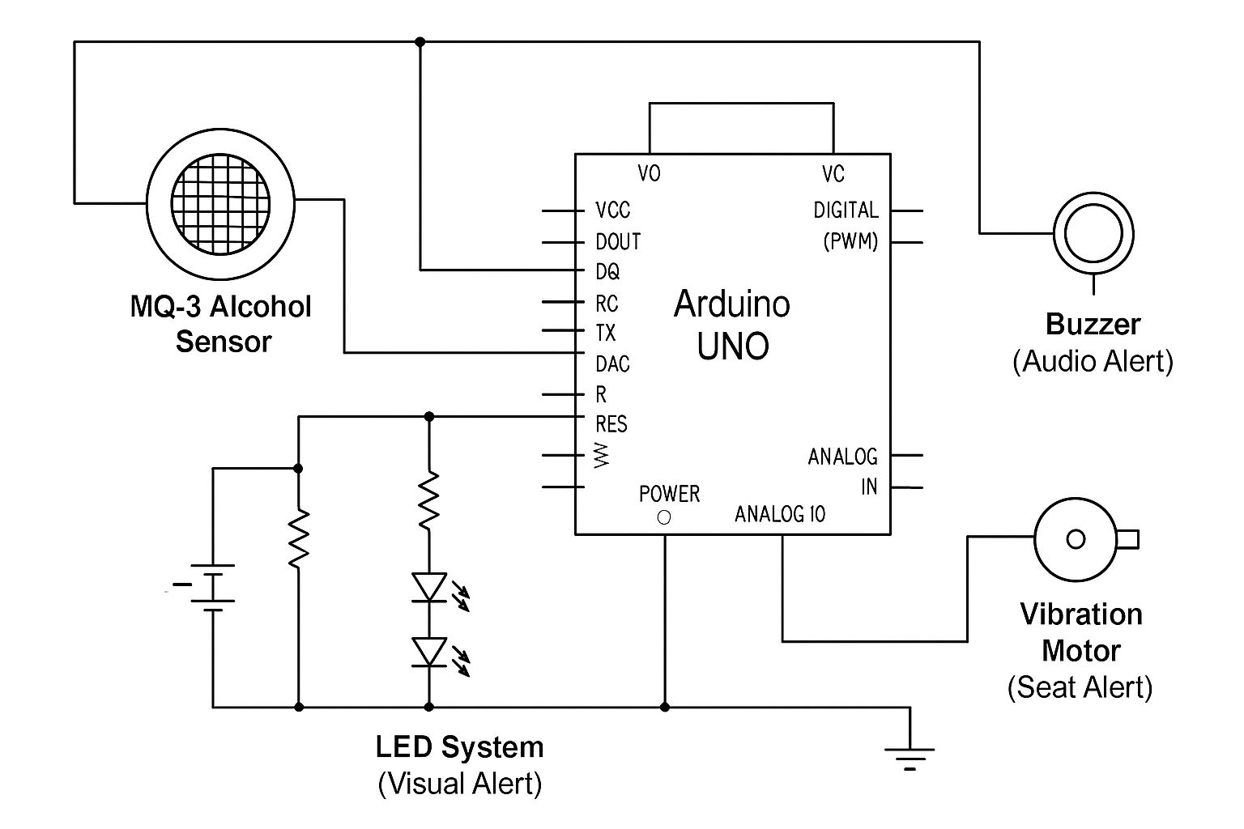
DESIGN - ARCHITECTURE
Output
Input
Output
Output

Slide 17
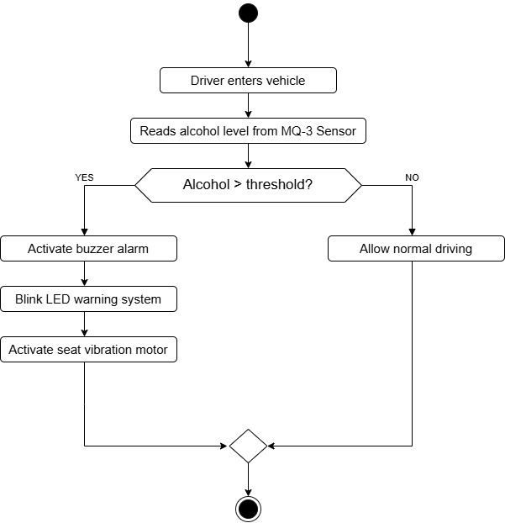
ACTIVITY DIAGRAM
UML DIAGRAMS

Slide 18
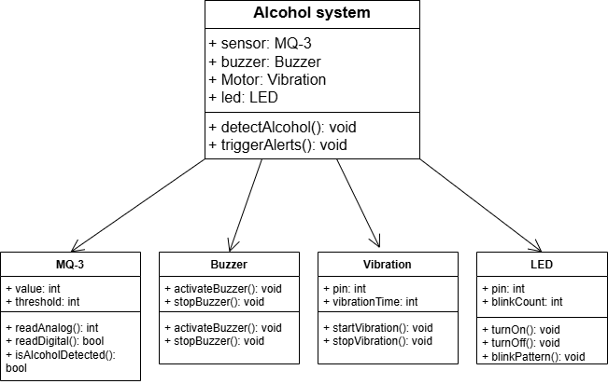
CLASS DIAGRAM

Slide 19
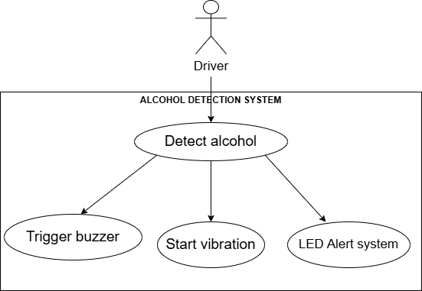
USE CASE DIAGRAM

Slide 20
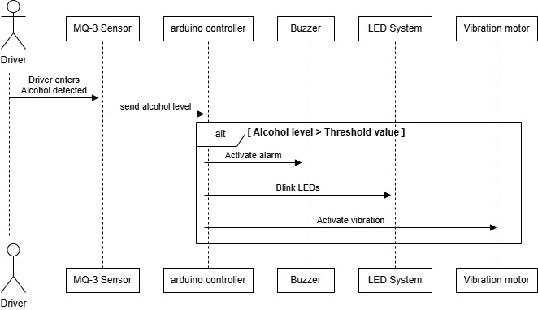
SEQUENCE DIAGRAM

Slide 21
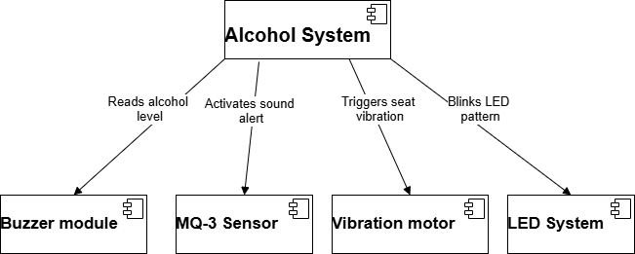
COMPONENT DIAGRAM

Slide 22
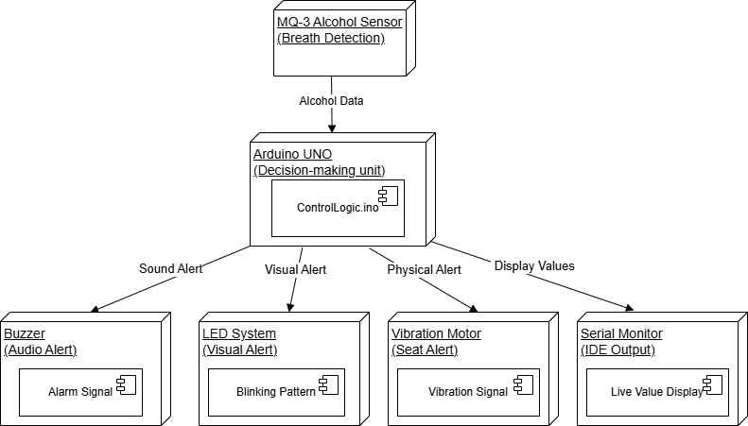
DEPLOYMENT DIAGRAM

Slide 23
#define sensorDigital 2
#define LED 3
#define buzzer 4
#define sensorAnalog A1
void setup() {
pinMode(sensorDigital, INPUT);
pinMode(LED, OUTPUT);
pinMode(buzzer, OUTPUT);
Serial.begin(9600);
}
void loop() {
bool digital = digitalRead(sensorDigital);
int analog = analogRead(sensorAnalog);
Serial.print("Analog value: ");
Serial.print(analog);
Serial.print("\t");
Serial.print("Digital value: ");
Serial.print(digital);
CODE

Slide 24
Serial.print("\t");
String alcoholLevel;
if (analog < 200) {
alcoholLevel = "Low";
} else if (analog < 700) {
alcoholLevel = "Moderate";
} else {
alcoholLevel = "High";
}
Serial.print("Estimated Alcohol Level: ");
Serial.println(alcoholLevel);
if (analog > 600) {
digitalWrite(LED, HIGH);
digitalWrite(buzzer, HIGH);
} else {
digitalWrite(LED, LOW);
digitalWrite(buzzer, LOW);
}
delay(1000);
}

Slide 25
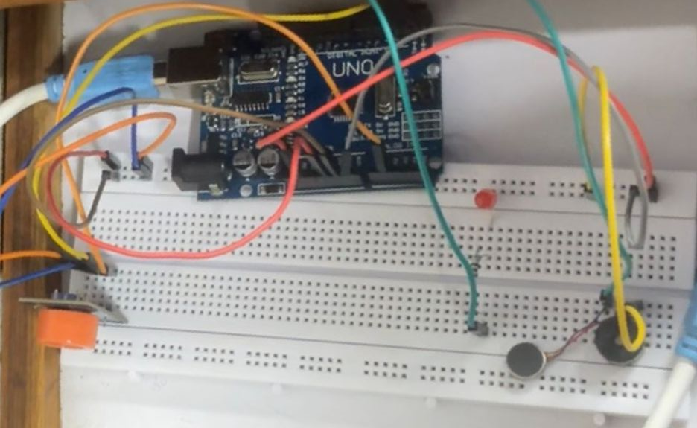
RESULTS

Slide 26
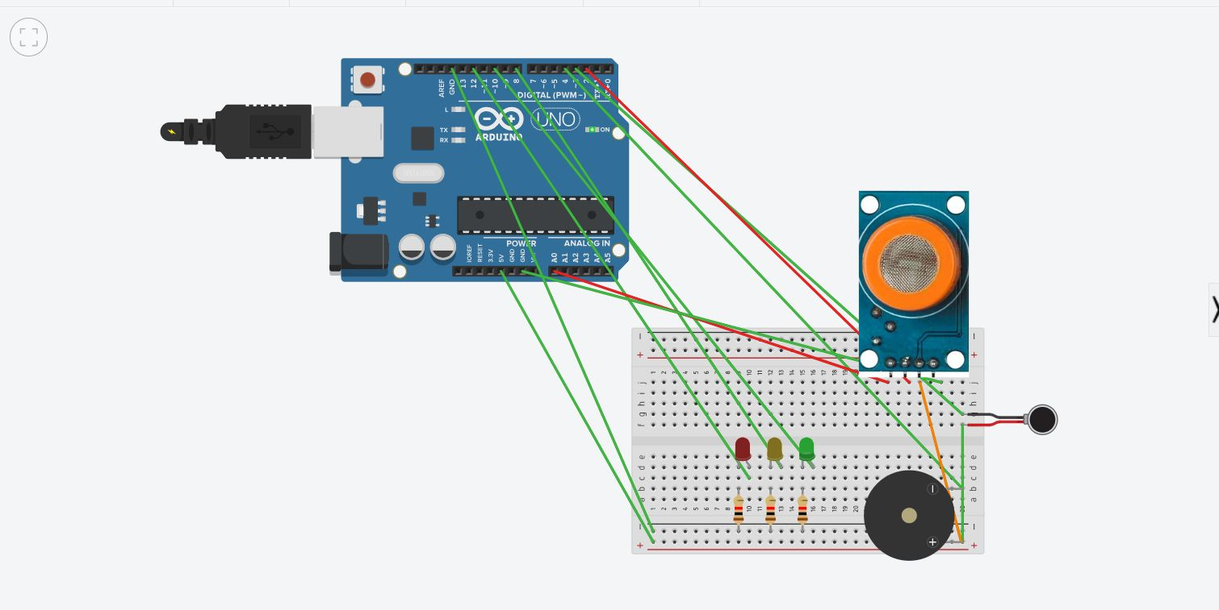

Slide 27
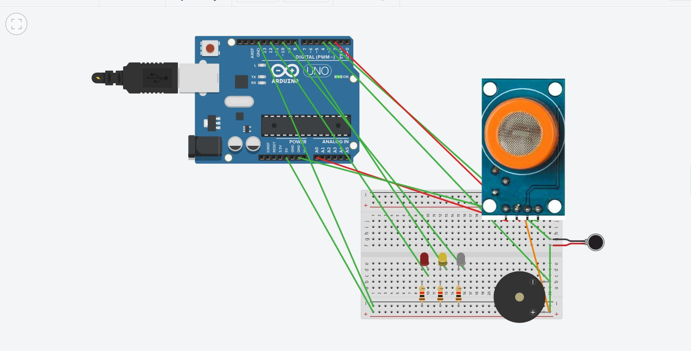

Slide 28
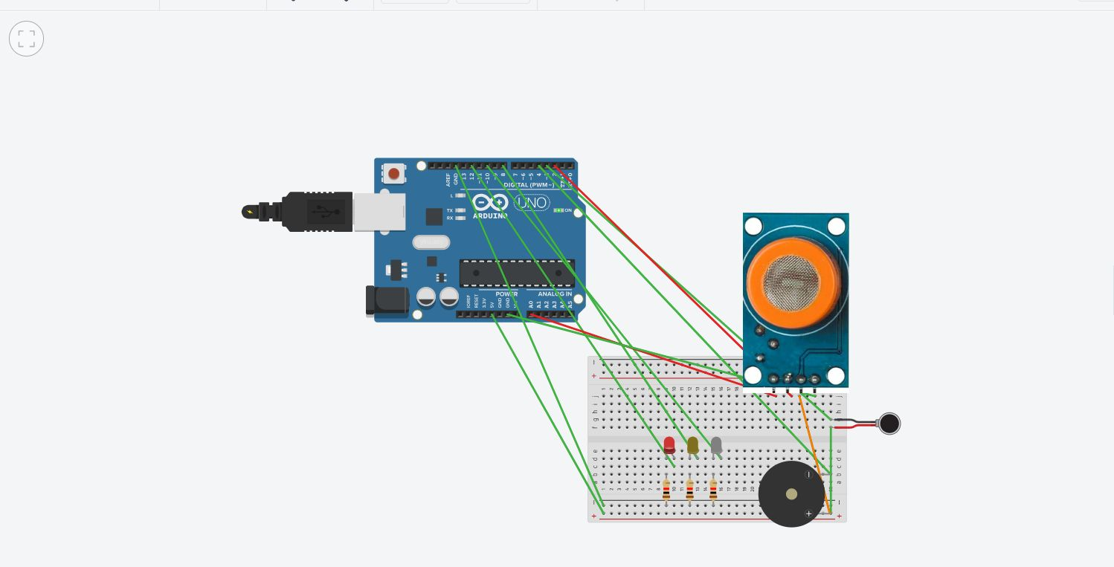

Slide 29
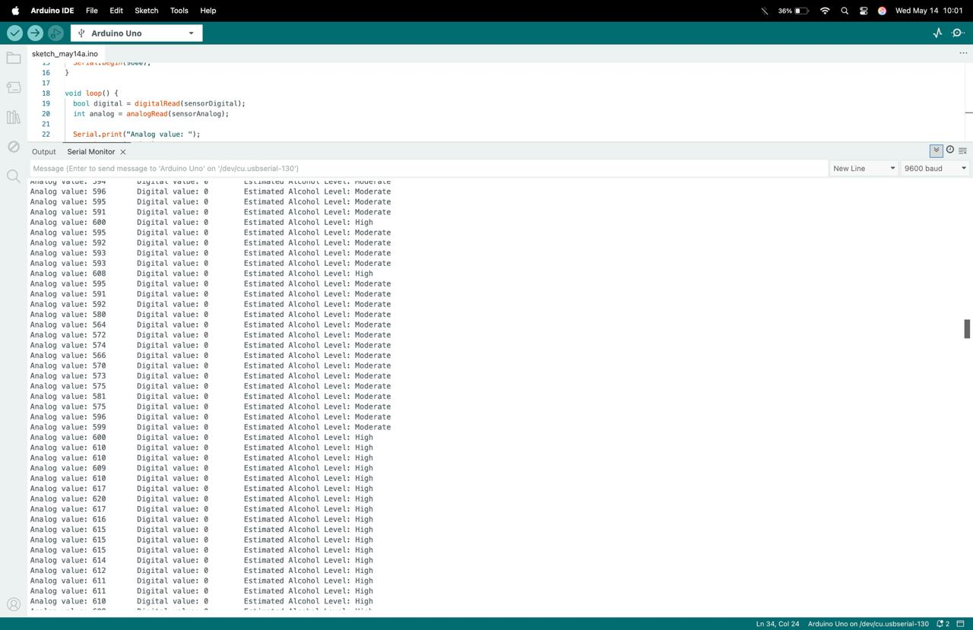

Slide 30
TEST CASES
Test Case ID | Test Case Name | Test Description | Expected Output | Actual Output | Remarks
TC_01 | System Initialization | Power on the system and initialize all components | MQ-3 sensor and output modules initialize successfully | MQ-3 sensor and output modules initialize successfully | Pass
TC_02 | Alcohol Detection | Exhale into the MQ-3 sensor with no alcohol | Sensor detects no alcohol; no alerts are triggered | Sensor detects no alcohol; no alerts are triggered | Pass
TC_03 | Alcohol Detection | Exhale into the MQ-3 sensor with alcohol present | Sensor detects alcohol; alert sequence is activated | Sensor detects alcohol; alert sequence is activated | Pass
TC_04 | Buzzer Alert | Trigger alert by exceeding alcohol threshold | Buzzer sounds continuously for defined duration | Buzzer sounds continuously for defined duration | Pass
TC_05 | LED System | Trigger alert via sensor | LEDs blink in pattern to indicate detection | LEDs blink in pattern to indicate detection | Pass

Slide 31
CONCLUSION
This project successfully demonstrates an alcohol detection and alert system using the MQ3 sensor and Arduino UNO. The system effectively detects the presence of alcohol in the breath of a vehicle driver and triggers a series of alerts, including an LED indicator and buzzer. Integrating this technology in vehicles can help prevent drunk driving incidents, increasing road safety. The design is low-cost, portable, and can be embedded in vehicle dashboards for real-time monitoring.

Slide 32
FUTURE ENHANCEMENTS
Engine Locking Mechanism: Implement a system that automatically disables the ignition if the driver is intoxicated.
Mobile App Support: Develop a companion mobile app for remote alerts, system monitoring, and logs.
Hydration & Health Monitoring: Add sensors to detect hydration levels or monitor pulse rate to assess driver health conditions.
Voice Assistant Notification: Integrate voice alert systems to warn the driver through speaker systems.

Slide 33
REFERENCES
L. M. Barba-Maza and C. Sánchez-López, "Development of a breathalyzer for car drivers," 2016 IEEE International Autumn Meeting on Power, Electronics and Computing (ROPEC), Ixtapa, Mexico, 2016, pp. 1-4, doi: 10.1109/ROPEC.2016.7830528.
M. Hariharan, M. Srinivas, V. B. Balantrapu, K. P. Sai Raju and N. Tanya, "Realtime Alcohol Detection and Engine Locking System with ESP8266," 2024 International Conference on Sustainable Communication Networks and Application (ICSCNA), Theni, India, 2024, pp. 1449-1453, doi: 10.1109/ICSCNA63714.2024.10864247.
Tamoghna Sarkar and Sukriti Shaw. 2020. IOT Based Intelligent Alcohol Detection System for Vehicles. In Proceedings of the 4th International Conference on Big Data and Internet of Things (BDIoT '19). Association for Computing Machinery, New York, NY, USA, Article 6, 1–5.
I. F. Rahmad, E. B. Nababan, L. Tanti, B. Triandi, E. Ekadiansyah and V. A. Fragastia, "Application of the Alcohol Sensor MQ-303A to Detect Alcohol Levels on Car Driver," 2019 7th International Conference on Cyber and IT Service Management (CITSM), Jakarta, Indonesia, 2019, pp. 1-5, doi: 10.1109/CITSM47753.2019.8965395.
R. -w. Li, Y. -p. Xiong, Y. -j. Wang and F. Wan, "Research on Infrared Breath Alcohol Test Based on Differential Absorption," 2009 First International Conference on Information Science and Engineering, Nanjing, China, 2009, pp. 4086-4089, doi: 10.1109/ICISE.2009.959.

